Slide 1
Energy Efficiency Economic Inclusion Index
Are Energy Efficiency Jobs Available for All?
BW Research, October 2017

Slide 2
Methodology
“Advantaged” and “Disadvantaged” Communities: Based on census tract data for income, demographics, educational attainment, language, and housing characteristics (i.e. low-income vs. high-income community)
Job Quality: Resident employment in (a) architecture and engineering, (b) construction and extraction, and (c) installation, maintenance, and repair
Energy Efficiency Index: Concentration of energy efficiency-related jobs for each occupational category by community

Slide 3
High-Income: Architecture and Engineering
Architecture and Engineering jobs are 1.6 to 2.5 times more concentrated in high-income communities.

Slide 4
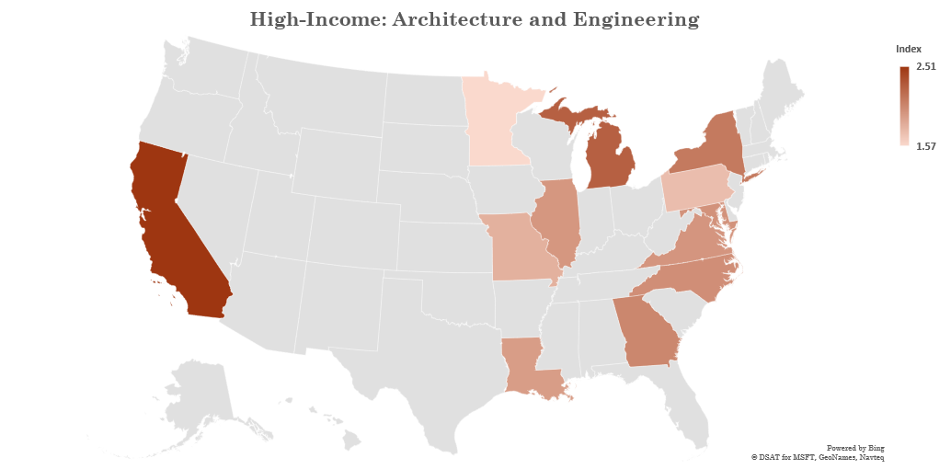
Overall contrast is most striking in California for nearly all metrics

Slide 5
White: Architecture and Engineering
Architecture and Engineering jobs are 1.2 to 1.8 times more concentrated in White communities.

Slide 6
Educated: Architecture and Engineering
Architecture and Engineering jobs are 1.5 to 3 times more concentrated in educated communities.

Slide 7
Undereducated: Construction and Extraction
Construction and extraction jobs are 1.7 to 4 times more concentrated in undereducated communities.

Slide 8
Undereducated: Installation, Repair and Maintenance
Installation and repair jobs are 1.5 to 2.3 times more concentrated in undereducated communities.

Slide 9
Energy Efficiency Jobs for All
Energy efficiency employment is everywhere, across advantaged and disadvantaged communities
Energy efficiency jobs provide sustainable wages, typically above the minimum wage and higher than food service and retail occupations
Disadvantaged communities have access to these sustainable wage occupations, indicated in the above average concentrations of construction and installation workers
15% of food prep and 3% of sales workers are paid at or below the minimum wage, compared to only 0.2% of construction and 0.5% of installation workers (Source: BLS 2016 Minimum Wage Workers)

Slide 10
Median Hourly Earnings by Occupation
Occupation | Median Hourly Earnings (Source: EMSI 2017)
Architecture and Engineering | $37.51
Construction and Extraction | $20.98
Installation, Maintenance and Repair | $20.86
Energy Efficiency Average | $23.95
All Occupations | $20.36
Sales | $12.99
Food Preparation and Service | $10.00

Slide 11
Energy Efficiency by Occupation
Job quality matters most – this is where we see inequality between advantaged and disadvantaged communities by income, demographics, ethnicity, education, and homeownership
Geographic variability but generally true across states and MSAs
Highest-paying energy efficiency jobs are in high-income, predominantly White, educated communities – greatest contrast in California
Low-wage energy efficiency jobs are mostly found in undereducated, ethnic, low-income, renter communities

Slide 12
Energy Efficiency Economic Inclusion Index
Are Energy Efficiency Jobs Available for All?
BW Research, October 2017

